Slide 1
WEEK - 9
Updates from - mqtt

Slide 2
Things we started with
The calculation of the total number of bytes needed for all the local variables
From here we can say how much more memory we need
With this we can for see what atmel chip would suit out reason better

Slide 3
Initial local variable calculation
Type | # | Size(byte) | Total(byte)
Long | 12 | 4 | 48
Int | 44 | 2 | 88
Bool | 6 | 1 | 6
String | 21 | 24 | 504
Uint_8 | 6 | 1 | 6
Uint_32 | 8 | 4 | 32
Char | 112 | 1 | 112
Char[10] | 1 | 2 | 2
Char[50] | 1 | 32 | 32
Total |  |  | 830 Bytes

Slide 4
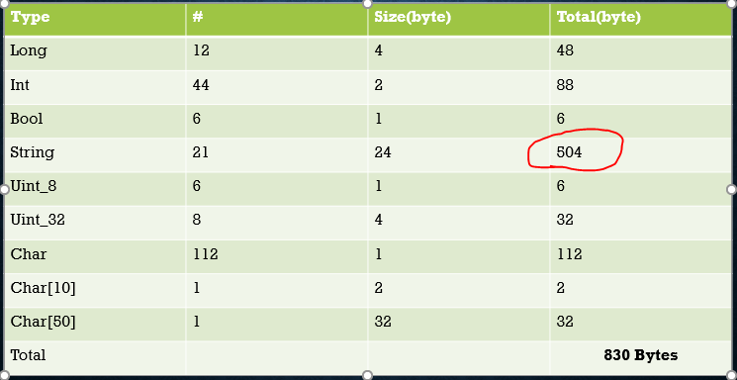
Over 60% of the memory needed are for the strings
Majority strings are the AT commands
Rest were AT reply comparisions

Slide 5
Lets talk in numbers
We need 830 bytes , but only left with 576 bytes
Global variable percentage should be ≈ (2048-830/2048)*100%
≈ 59%
Current global variable percentage : 71%

Slide 6
Changes made…..
Adapted an optimized way of string comparison
Saved the strings in program memory
Optimized way in saving and Serial printing the AT commands
Most of the AT commands were saved in the Flash memory

Slide 7
After the changes
Type | # | Size(bytes) | Total
Long | 12 | 4 | 48
Int | 42 | 2 | 84
Bool | 4 | 1 | 4
String | 1 | 24 | 24
Uint_8 | 6 | 1 | 6
Uint_32 | 8 | 4 | 32
Char | 59 | 4 | 59
Char[10] | 1 | 2 | 2
Char[50] | 1 | 32 | 32
Total |  |  | 291 bytes

Slide 8
Lets talk again
Sketch uses 10282 bytes (33%) of program storage space.
Maximum is 30720 bytes.
Global variables use 1220 bytes (59%) of dynamic memory,
leaving 828 bytes for local variables.
Maximum is 2048 bytes.

Slide 9
What next ..?
The device has been attached for testing with the optimized library starting from 28th Aug , for 15 continuous days
- will be checking whether the device is having stack over flow
- will be checking whether the watch dog timer is activated
The optimized library will be uploaded to bitbucket for future purposes

Slide 10
Capabilities of the library
The optimized library can perform as a fully functional IOT library, at global variable level 59%
-subscribe
-transmit
-receive
-publish message
**of course we don’t need all these features in all the devices which will be using this library, but its an added advantage.

